Slide 1

Principles of adaptation of goats to life in harsh environments
Nissim Silanikove
Department of Physiology and Nutrition, Institute of Animal Science
Agricultural Research Organization, The Volcani Center,
P.O. Box 6, Bet Dagan 50 250, Israel.

Slide 2
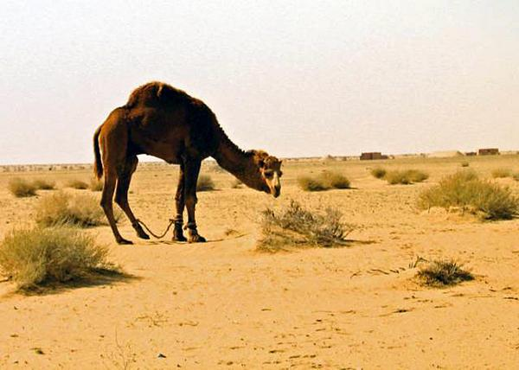
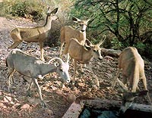
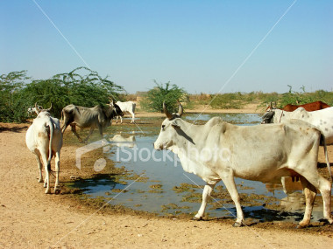
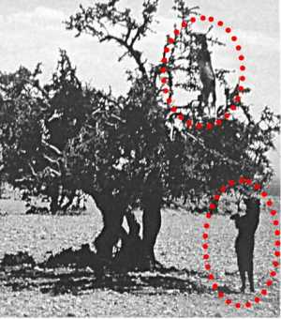
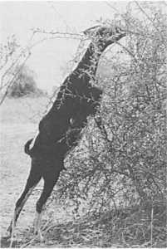
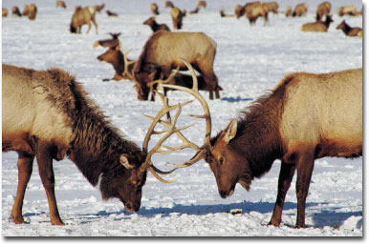
In order to be sure what’s our goals are, we should know how we came to this point and where we stands now

Slide 3
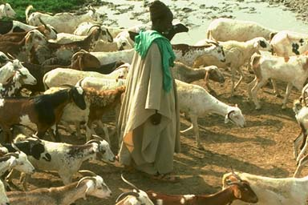
Goats seem to have been first domesticated roughly 10,000 years ago in Asia Minor, Persia and Pakistan
Ancient cultures and tribes began to keep them for easy access to milk, hair, meat, and skins. This methods are utilized today

Slide 4
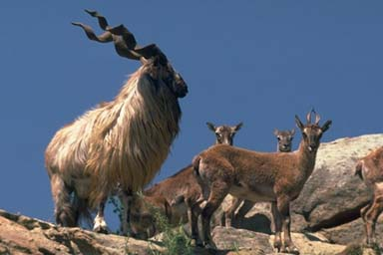
The domestic goat (Capra aegagrus hircus) is a domesticated subspecies of the wild goat of southwest Asia .
Markhor (Wilde goat from Pakistan)

Slide 5
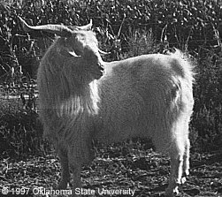
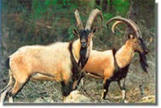
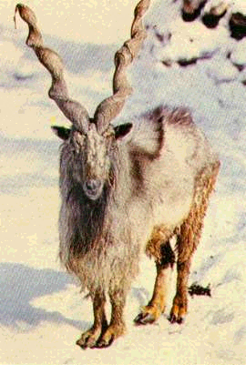
Goats ancestors

Slide 6


Slide 7
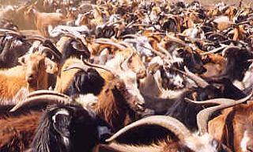
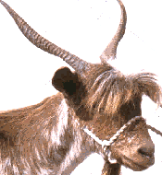
Criolla (Argentina) herd

Slide 8
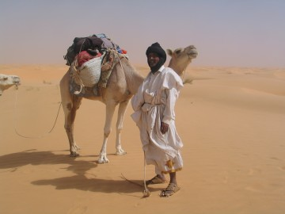

Slide 9
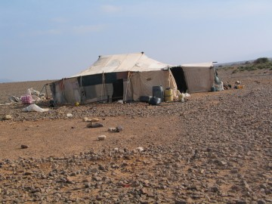

Slide 10
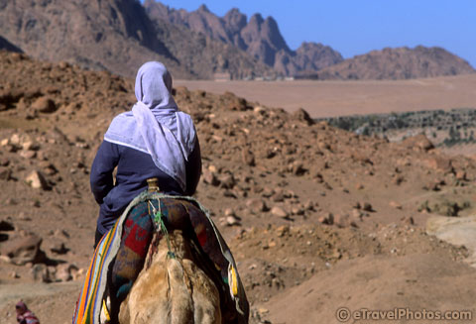

Slide 11
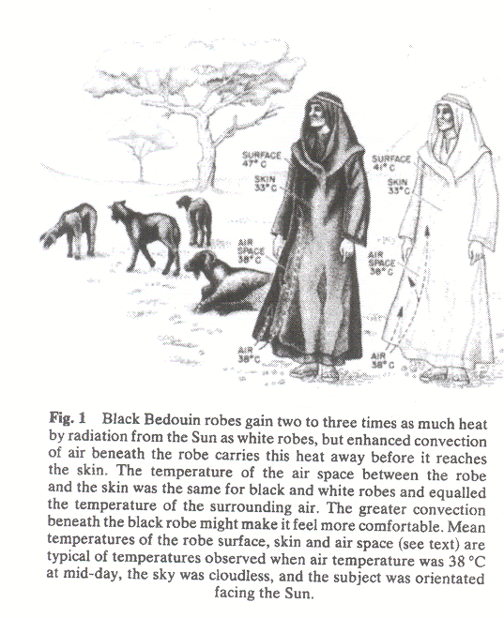

Slide 12
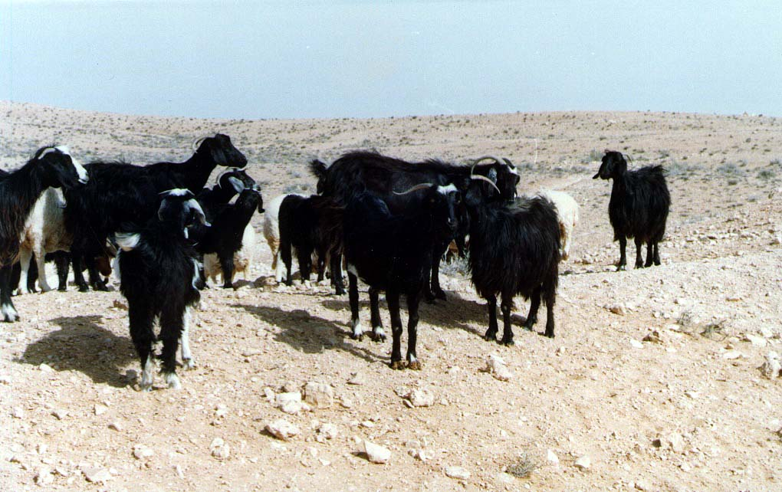

Slide 13
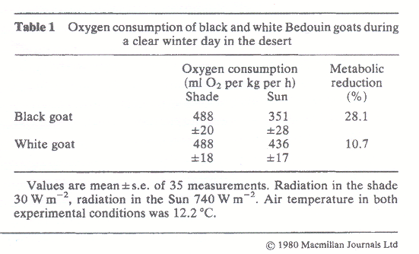

Slide 14
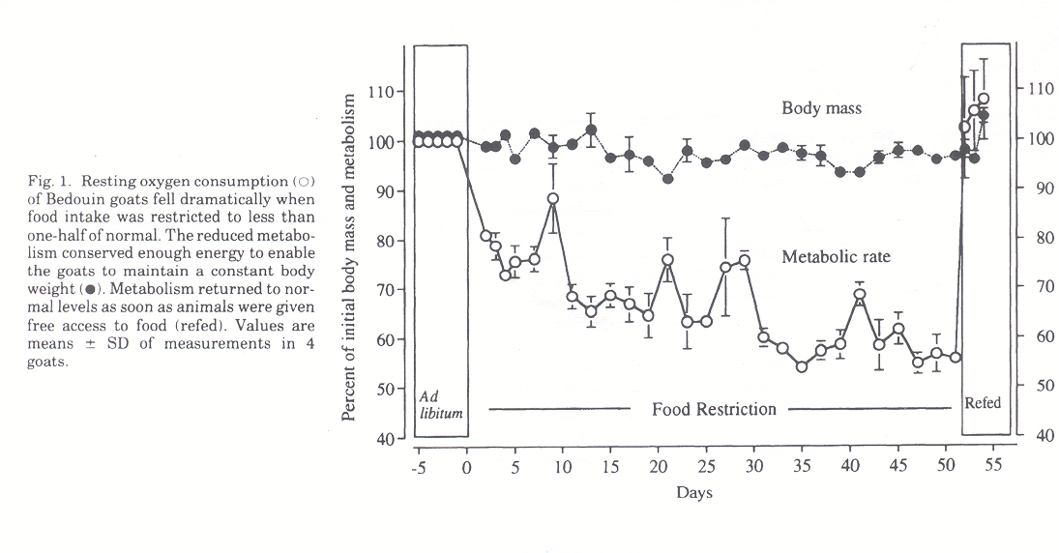

Slide 15
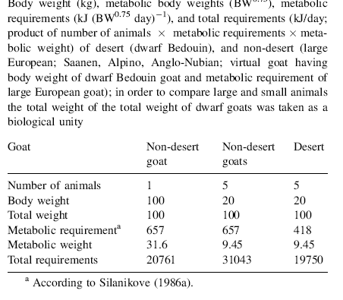

Slide 19
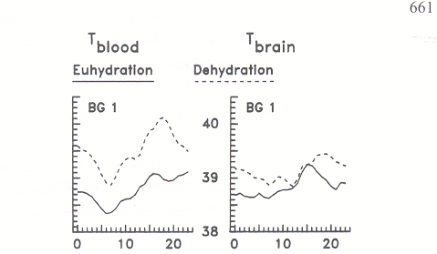
Arterial Vs. Brain temperature in hydrated and dehydrated Bedouin goats

Slide 20
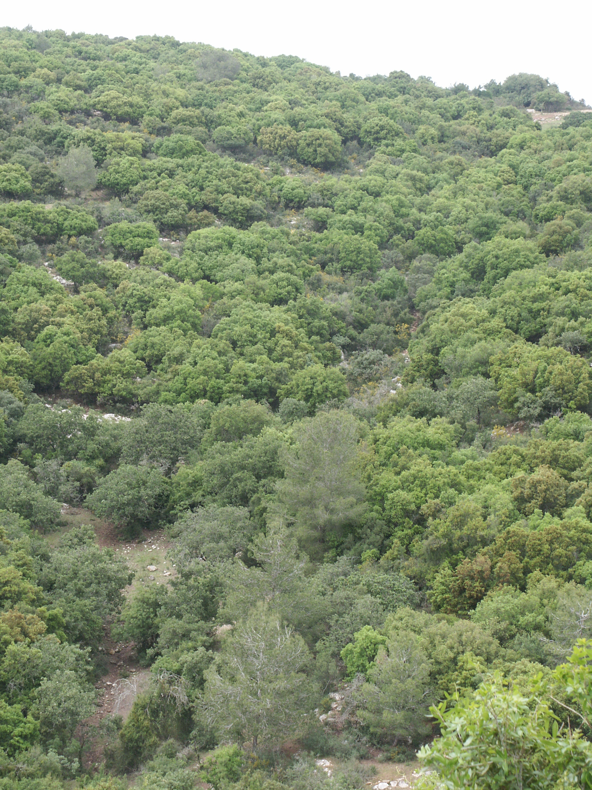
The Mediterranean woodland and pine trees

Slide 21

Diet composition in goats grazing
on a Mediterranean woodland
protein-oak
protein-herb.
15
protein-ramn.
10
protien-diet
Content (%)
tannin-ramn.
5
tannin-oak
tannin-diet
Time (250 days)

Slide 23
Principles of adaptations to harsh environment
The strain: heat and radiation
The adaptation: physiological and behavioral thermoregulation
The strain: Shortage in water
The adaptation:Low requirement, a capacity to endure severe dehydration and rapid rehydration
The strain: Shortage of energy protein and essential nutrients
The adaptation:Small body size, low and variable metabolic requirements, superior digestive capacity, efficient use of key metabolites (recycling), skilful grazing behavior.

Slide 24
Environment or genotype?
To optimize productivity it is necessary to study both factors: modification of components of the environment and genetic differences in response to them.

